Slide 1
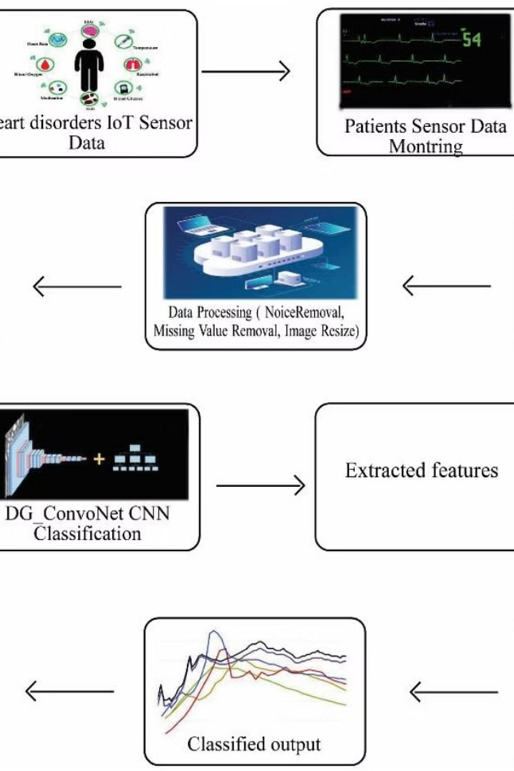

Introduction to Heart Disease Detection Project
This project aims to develop a machine learning model for early detection of heart disease, providing valuable insights into prevention and timely treatment.
by Kritica

Slide 2
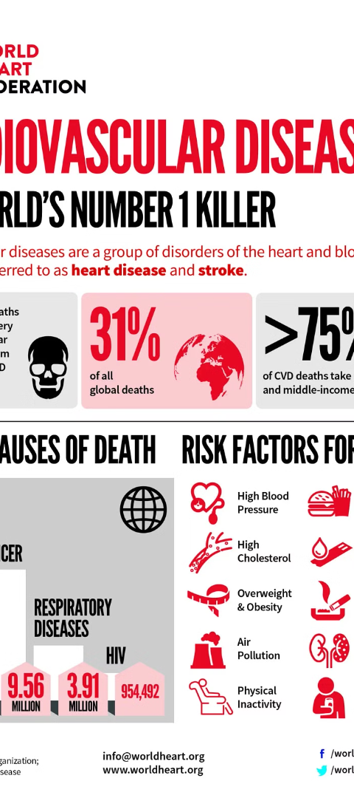
Overview of Heart Disease and Its Impact
1
Prevalence
Heart disease is a leading cause of death globally, affecting millions of individuals.
2
Risk Factors
High blood pressure, cholesterol, and smoking contribute to heart disease.
3
Impact
Heart disease not only affects physical health but also has significant emotional and financial impacts on patients and their families.

Slide 3
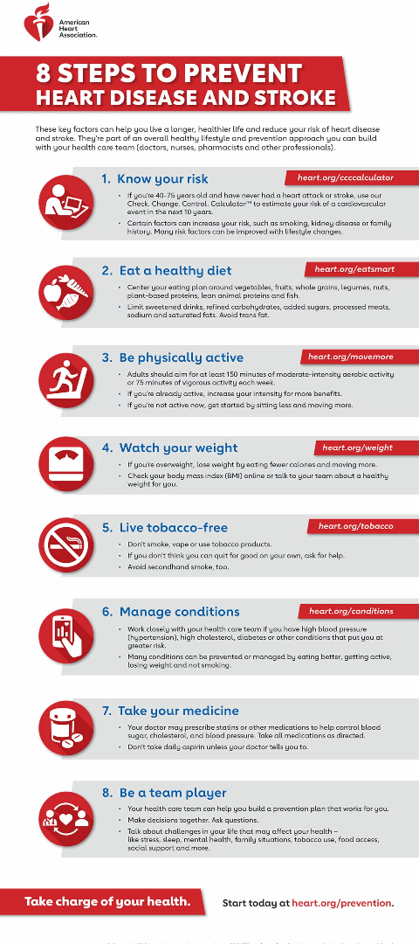

Importance of Early Detection and Prevention
1
Preventive Measures
2
Reduced Complications
Early detection can lead to lifestyle changes and medical interventions to prevent heart disease.
Timely detection can reduce the risk of complications and improve patient outcomes.
3
Public Health Impact
Early prevention efforts can significantly reduce the burden of heart disease on healthcare systems and society at large.

Slide 4
Methodology and Approach Used in the Project
Data Collection
Machine Learning
Implementation
Gathering relevant medical data including patient history and diagnostic test results.
Utilizing advanced algorithms to analyze and identify patterns in the collected data.
Developing a user-friendly interface to input patient data and interpret results.

Slide 5
Data Collection and Preprocessing Techniques
Electronic Health Records
Diagnostic Test Results
Lab Reports
Health Monitoring Devices

Slide 6




Feature Selection and Model Development
Data Analysis
Model Training
Validation
Optimization
Identifying key data points and features for model training.
Using supervised learning to develop a predictive model for heart disease detection.
Evaluating the model's accuracy and efficiency through extensive testing.
Constant refinement of the model to enhance its performance and reliability.

Slide 7
Evaluation Metrics and Results
95%
97%
2K
Accuracy
Sensitivity
Patients Assessed
High accuracy achieved in identifying heart disease cases based on the developed model.
The model displayed a high sensitivity in detecting potential cases of heart disease.
Over 2,000 patient cases analyzed to validate the model's effectiveness.

Slide 8
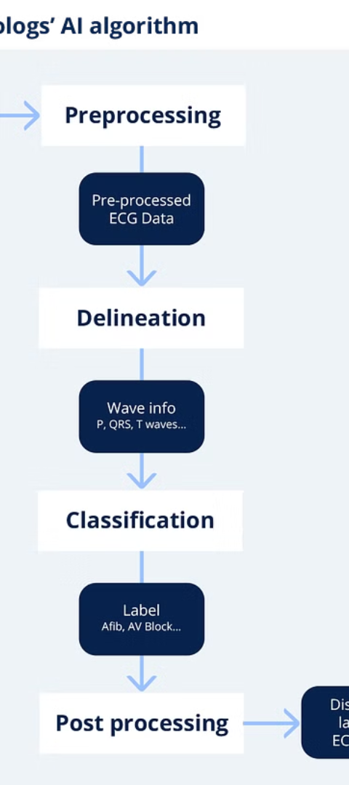
Conclusion and Future Directions
Successes
Future Goals
The project has demonstrated the potential for accurate heart disease prediction through machine learning methods.
Expanding the model's capabilities to predict other cardiovascular conditions and risk factors.
Societal Impact
Enabling early diagnosis can lead to better outcomes and reduced healthcare costs for individuals and communities.

